Slide 1
PERFORMANCE OF CHOCK SHIELD SUPPORT IN LONGWALL SYSTEM
By -
ishita Mishra(1)

Slide 2
INTRODUCTION
LONGWALL MINING IS THE EFFICIENT AND HIGH PRODUCTION MINING METHOD
SUCCESS OF LONGWALL SYSTEM DEPENDS ON POWER SUPPORT SYSTEMS
MORE THAN 50% OF THE EQUIPMENT COST REQUIRED FOR LONGWALL IS MET BY POWER SUPPORT SYSTEMS
CHOCK SHIELD IS THE MOST MODERN SYSTEM OF PROVIDING SUPPORT
THE USAGE OF CHOCK SHIELD INCREASES THE SUPPORT AS WELL AS PRODUCTION CAPACITY.

Slide 3
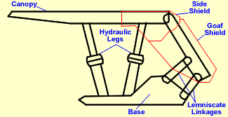
CONSTRUCTIONAL FEATURES
COMPONENTS OF CHOCK SHIELD SUPPORT –
HYDARULIC LEGS
CANOPY
SHIELD
BASE

Slide 4
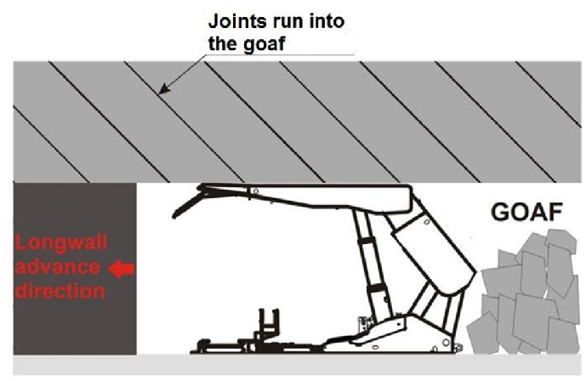
SIGNIFICANCE OF CHOCK SHIELD SUPPORT
PROVIDES SUPPORT TO STRATA
PUSHES FACE CHAIN CONVEYOR
PROVIDES SAFE ENVIRONMENT FOR MINING ACTIVITIES
SUITABLE FOR MEDIUM TO HARD ROOF

Slide 5
Factors influencing load
Setting load density
Height of caving block
Yield characteristics
Presence of fractured zones near the face

Slide 6
ADVANTAGES
KINEMATICALLY STABLE
ANGLE OF INCLINATION OF LEGS CAN VARY WITH MINIMUM HEIGHT
HIGH SUPPORTING EFFICIENCY
IT PROMOTED THE APPLICATION OF LONGWALL MINING IN DIFFICULT TO CONTROL CAVING SYSTEM
COMBINED ADVANTAGES OF BOTH CHOCK AND SHIELD
USED FOR BOTH THICK AND THIN COAL SEAMS

Slide 7
conclusion
The chock shield support is the most modern support system and it increases the production of coal in underground coal mines. It also increases the safety by providing a support with a lengthier canopy. Overall its usage should be increased to increase the safety and production of coal.

Slide 8
REFERENCES
TEXT REFERENCES-
CHOCK SHIELD SUPPORTS – Mining Science and Technology (miningst.com)
Excess date – 10/04/2023
2. Chock Shield Support Systems | Dowty Mining Equipment | Dowty Heritage
Excess date – 09/04/2023
IMAGE REFERENCES-
CHOCK SHIELD SUPPORTS – Mining Science and Technology (miningst.com)
excess date – 11/04/2023
https://www.researchgate.net/figure/the-longwall-parallel-joints-in-the-roof-strata-run-into-the-goaf_fig6_304400497
Excess date – 12/04/2023

Slide 9
THANK YOU

